Slide 1
Guest Lecture Stanford ME469: Multiphysics Coupling
Stefan P. Domino
Computational Thermal and Fluid Mechanics
Sandia National Laboratories SAND2018-4536 PE

Slide 2
Multiphysics Coupling: Outline
Examples of multiphysics coupling with emphasis on fluids, PMR, and CHT
Monolithic vs Operator Split
Details of PMR/Fluids Coupling
Details of PMR/Thermal Coupling
Details of Fluids/Thermal Coupling
Verification
Stability
Conclusions

Slide 3
We Live in a Multiphysics World
Fluid/Structure coupling:
Wind turbines
Wing fluttering, etc.
Non-isothermal fluids/participating media radiation:
Fires,
Natural gas and coal combustion,
Smelting, ethlyne production, etc.
Conjugate heat transfer:
Object-in-fire
Gas turbine fine cooling
Often times, we note a time and length scale disparity
For example, consider heating a pan on a home burner
The coupling architect must generally choose between monolithic and split
For monolithic, the equations are provided, therefore, the challenge becomes managing a monolithic sytem solve, storage and code design
For operator split, there can be an “art” in determination of stable couplings due to Eignevalue spread

Slide 4
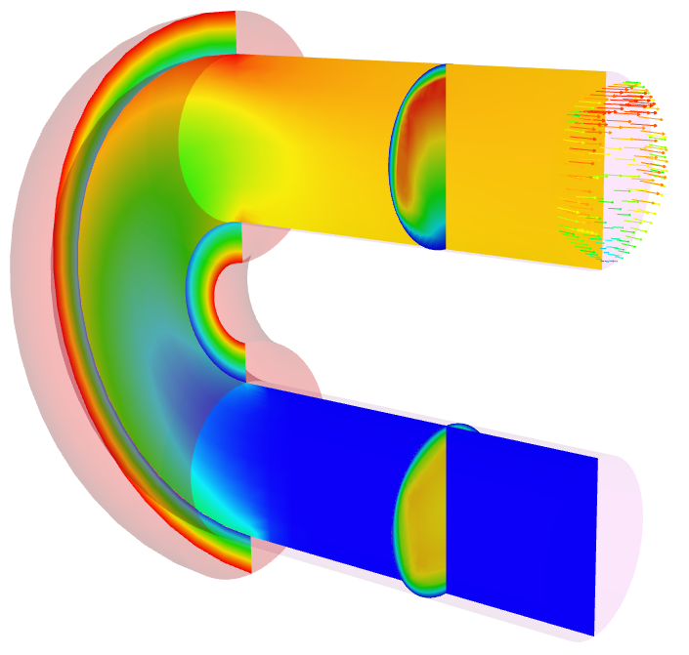
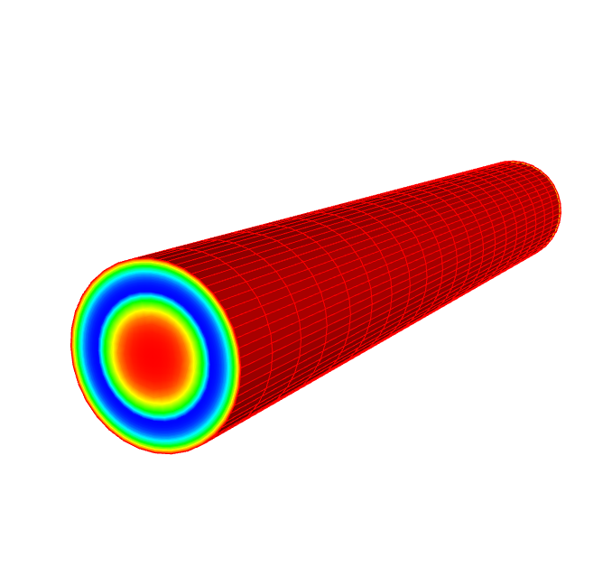
Conjugate Heat Transfer Coupling
Thermal
Common in engineering applications that require efficient heating or cooling of objects
Conduction
Heat Transfer,
Enclosure Radiation
1 DOF/node
+ chemistry
Tb
Temperature
SURFACE
Convection Coef/Temp .
Fluids
Turbulent
Fluid Mechanics,
Combustion
15 dof/node
Tb
Turbulent pipe CHT

Slide 5
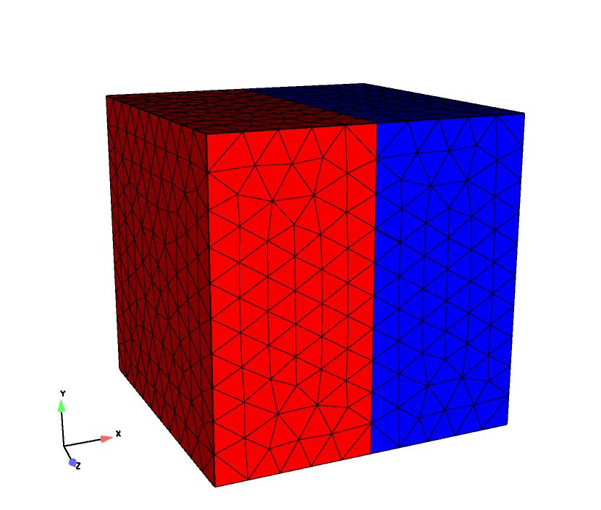
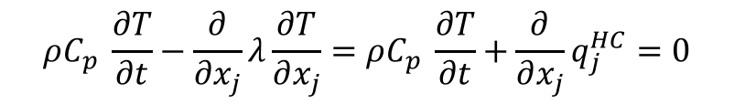
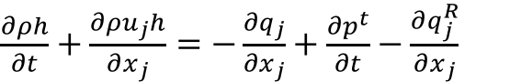
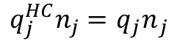
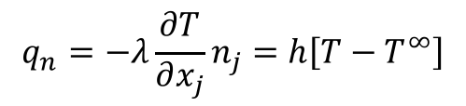
Conjugate Heat Transfer Coupling, Equations
Favre-averaged static enthalpy equation:
Thermal heat conduction
Interface condition
$\frac{∂ρh}{∂t}+\frac{∂ρu_{j}h}{∂x_{j}}$ $=−\frac{∂q_{j}}{∂x_{j}}+\frac{∂p^{t}}{∂t}−\frac{∂q_{j}^{R}}{∂x_{j}}$
$$ρC_{p} \frac{∂T}{∂t}−\frac{∂}{∂x_{j}}λ\frac{∂T}{∂x_{j}}=ρC_{p} \frac{∂T}{∂t}+\frac{∂}{∂x_{j}}q_{j}^{HC}=0$$
$$q_{n}=−λ\frac{∂T}{∂x_{j}}n_{j}=h\left[T−T^{∞}\right]$$
$q_{j}^{HC}n_{j}=$ ${q_{j}n}_{j}$

Slide 6
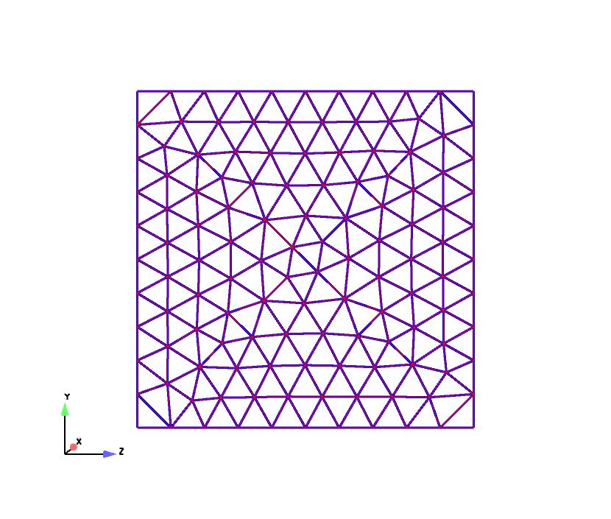

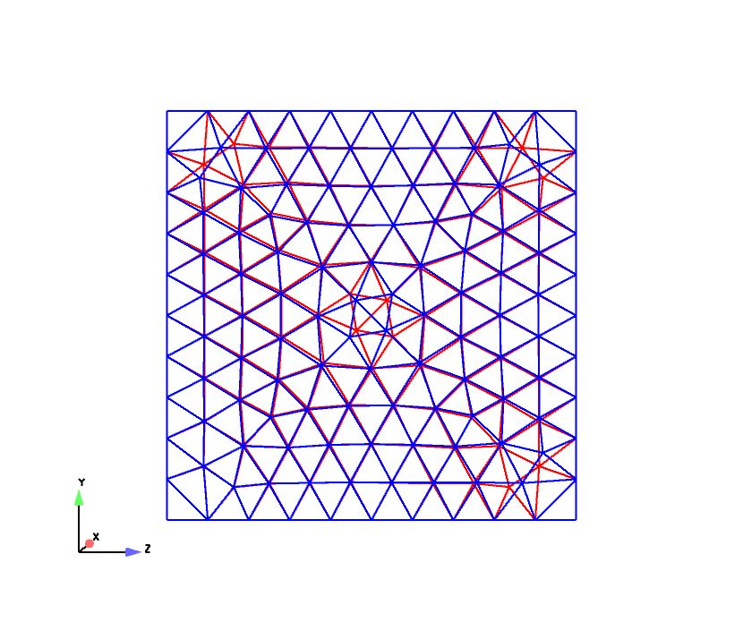
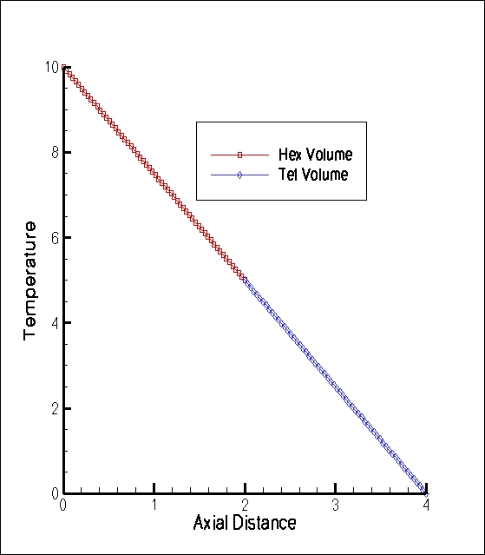
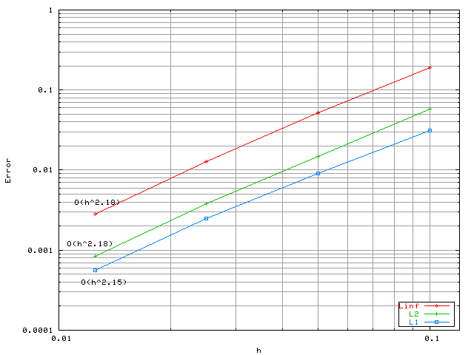
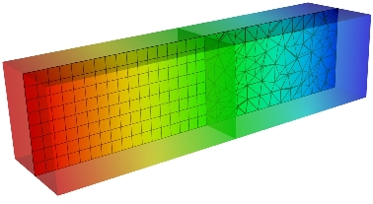
Fluid/CHT Coupling Verification
Unstructured heterogeneous mesh capability
Arbitrary geometric complexity
Multi-block domain variable transfer
Conforming interface
Non-
conforming interface
Linear (patch test)
Trigometric MMS

Slide 7
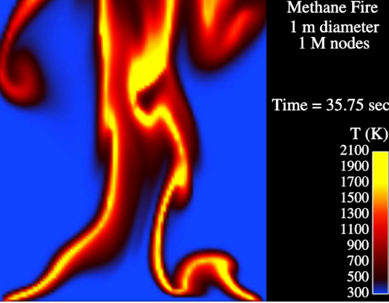
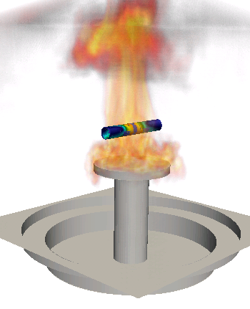
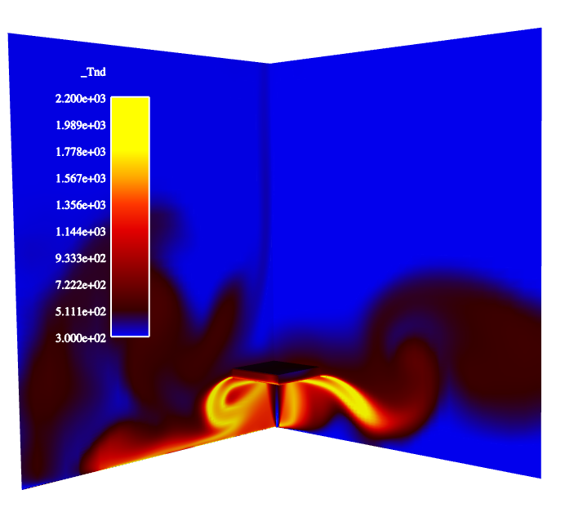
Fluids/PMR Coupling
PMR
Participating
Media
Radiation
n(n+2) DOF/node
T, μ, S_{RTE}
Pool fire
VOLUME
Fluids
Turbulent
Fluid Mechanics,
Combustion
15 dof/node
Deflected reacting jet

Slide 8
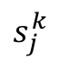


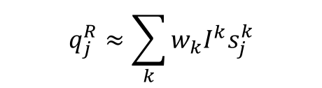
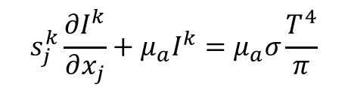
Fluids/PMR Coupling Equations
Favre-averaged static enthalpy equation:
Steady, non-scattering Radiative Transport Equation
Scalar Flux,
Divergence of radiative flux,
$\frac{∂ρh}{∂t}+\frac{∂ρu_{j}h}{∂x_{j}}$ $=−\frac{∂q_{j}}{∂x_{j}}+\frac{∂p^{t}}{∂t}−\frac{∂q_{j}^{R}}{∂x_{j}}$
$$s_{j}^{k}\frac{∂I^{k}}{∂x_{j}}+μ_{a}I^{k}=μ_{a}σ\frac{T^{4}}{π}$$
$$G≈\sum_{k}{w_{k}I^{k}}$$
$$s_{j}^{k}$$
$$q_{j}^{R}≈\sum_{k}{w_{k}I^{k}s_{j}^{k}}$$
$$\frac{∂q_{j}^{R}}{∂x_{j}}=μ_{a}\left[4{σT}^{4}−G\right]$$
Quadrature

Slide 9
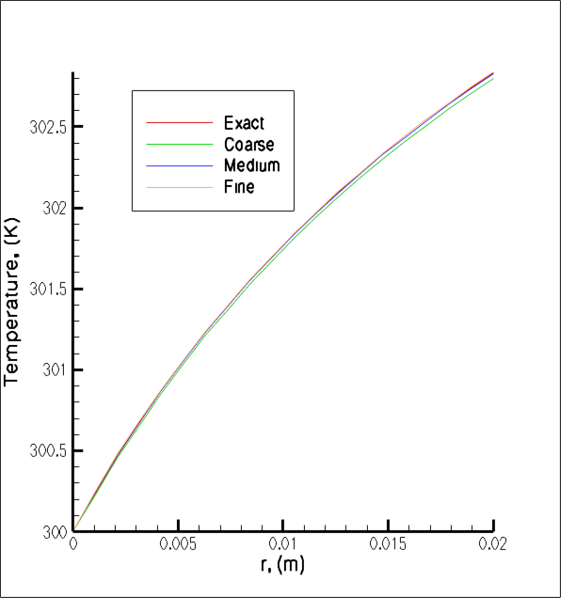
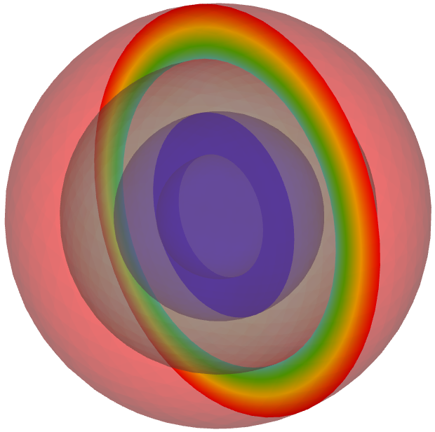
PMR/Thermal Coupling
Thermal
Temperature
PMR
Conduction
Heat Transfer,
Enclosure Radiation
1 DOF/node
+ chemistry
SURFACE
Participating
Media
Radiation
n(n+2) DOF/node
Irradiation
r_{o}, T_{o} = 0.1 m, 600K
r₂, T₂ = 0.075 m, 599.291K
r₁, T₁ = 0.05 m, 302.834K
r_{i}, T_{i} = 0.03 m, 300K
PMR:Conduction through concentric spheres
O(1.8) with faceting,
O(2) without

Slide 10
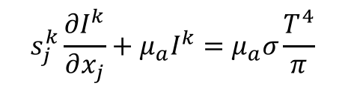
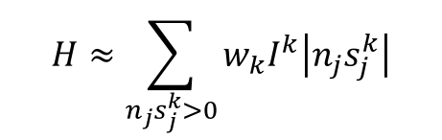
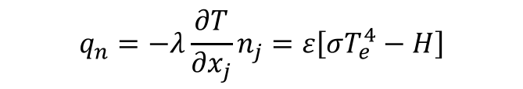
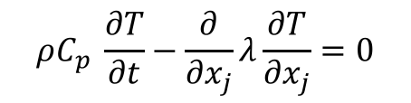
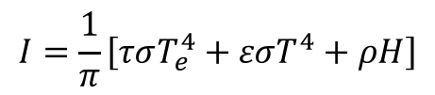
PMR/Thermal Coupling Equations
Steady, non-scattering Radiative Transport Equation
Irradiation (incoming),
Grey, diffuse boundary condition (given transmissivity, τ, emissivity ε, and reflectivity, ρ
With boundary condition,
$$s_{j}^{k}\frac{∂I^{k}}{∂x_{j}}+μ_{a}I^{k}=μ_{a}σ\frac{T^{4}}{π}$$
$$H≈\sum_{n_{j}s_{j}^{k}>0}{w_{k}I^{k}\left|n_{j}s_{j}^{k}\right|}$$
$$I=\frac{1}{π}\left[τσT_{e}^{4}+εσT^{4}+ρH\right]$$
$$q_{n}=−λ\frac{∂T}{∂x_{j}}n_{j}=ε\left[σT_{e}^{4}−H\right]$$
$$ρC_{p} \frac{∂T}{∂t}−\frac{∂}{∂x_{j}}λ\frac{∂T}{∂x_{j}}=0$$

Slide 11
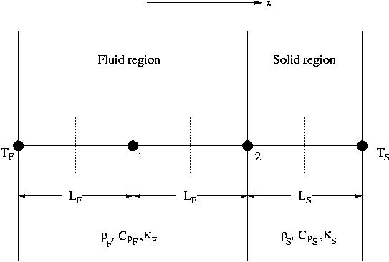
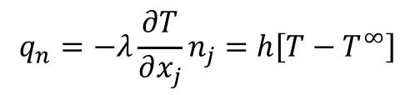
Conjugate Heat Transfer Stability
Consider a simple CHT problem
Compute amplification factor
Requiring:
CHT via flux transfer:
Explicit RHS
Unstable for certain time steps and material properties
CHT via convection coefficient:
Implicit LHS
Unconditionally stable
Simplified 1D geometry with 2 nodes for stability analysis of CHT
$$q_{n}=−λ\frac{∂T}{∂x_{j}}n_{j}=h\left[T−T^{∞}\right]$$

Slide 12
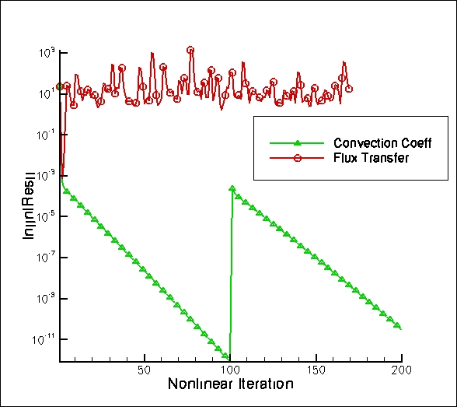
Conjugate Heat Transfer Stability, In Practice
Transient heated laminar pipe in a 180 degree bend
Water, Re = 2000, inflow T = 300
Copper jacket, boundary – 350K

Slide 13
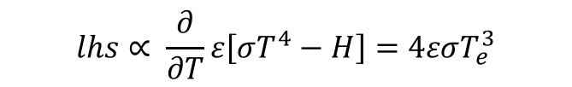

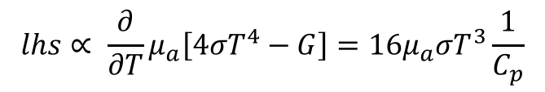
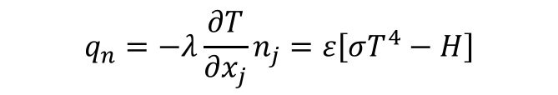
Other Linearization Procedures
PMR and heat conduction radiative boundary condition:
PMR and fluids coupling, linearized divergence of the radiative flux,
In practice, such procedures enhance stability for the multi-physics coupling
In the case of Fluids/CHT, one could possibly monolitically couple the systems
In the case of Fluids/PMR, monolithic coupling is not practical as the intensity system is ~ N², where N is generally O(8)
$$q_{n}=−λ\frac{∂T}{∂x_{j}}n_{j}=ε\left[σT^{4}−H\right]$$
$$lhs∝ \frac{∂}{∂T}ε\left[σT^{4}−H\right]=4εσT_{e}^{3}$$
$$\frac{∂q_{j}^{R}}{∂x_{j}}=μ_{a}\left[4{σT}^{4}−G\right]$$
$$lhs∝ \frac{∂}{∂T}μ_{a}\left[4{σT}^{4}−G\right]=16μ_{a}σT^{3}\frac{1}{C_{p}}$$

Slide 14
Multiphysics Coupling: Conclusions
Multiphysics applications are abundant in engineering applications
Turbulent, reacting flow with PMR and CHT requires a wide range of length and time scale resolution
Monolithic approaches are ideal from a splitting perspective, however, can be prohibitively expensive when considering systems such as PMR
Linearization can augment time step stability and should be exploited when possible

